Slide 1


Data compression and coding
Andrei Toader

Slide 2
scope
Data compression:
- An ensemble of processing applied to some data in order reduce the size of it.
Data coding:
- A term generally used to refer to the entire data-compression process instead of a single component of that process

Slide 3
The two kingdoms
Data compression techniques can be divided into two major families:
Lossy
Lossless

Slide 4
Lossy compression
This is proved very effective when applied to graphics image and digitized voice.
Most lossy compression techniques can be adjusted to different quality levels, gaining higher accuracy in exchange for less effective compression.

Slide 5
Lossless compression
After a compression/decompression cycle, an exact duplicate of the input data stream is received.
This is used where we need an exact representation of what initially was:
Database records, spreadsheets, files etc…

Slide 6
Modeling + coding
Data compression consists of taking a stream of symbols and transforming them into codes.
The decision to output a certain code for a certain symbol is based on a model.
Model == a collection of data and rules used to process input symbols and determine which code to output.

Slide 7

Run length encoding - RLE
It is based on the coding of repetitive sequences.
“Runs” are replaced with a tripled representing the repeated character, a repetition marker, and the repetition length.

Slide 8
Modeling + coding
Simplest form of modeling is the use of a static table of probabilities.
Using a universal static model has limitations (obviously). If the input stream doesn’t match well, the compression ratio will be degraded.
The next obvious enhancement => building a statistics table for every unique input stream.

Slide 9
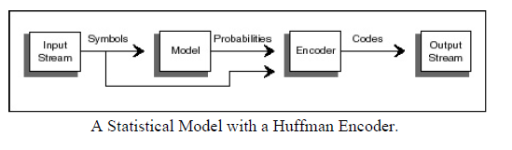
Statistical Huffman

Slide 10
Statistical Huffman
Pros: the table is uniquely adapted to that particular file, so it should give better compression than an universal table
Cons: Additional overhead since the table (or the statistics used to build the table) has to be passed to the decoder ahead of the compressed code stream.

Slide 11
Adaptive model
When using an adaptive model, data does not have to be scanned once before coding in order to generate statistics.
The statistics are continually modified as new characters are read in and coded.

Slide 12
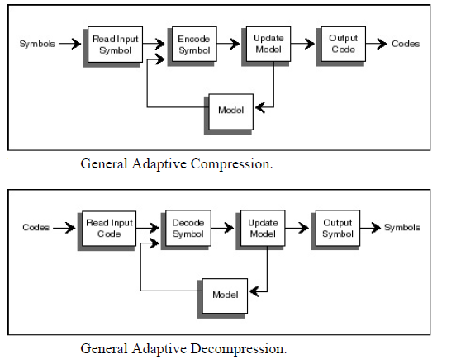
Adaptive model

Slide 13
Dictionary schemes
A dictionary scheme reads in input data and looks for groups of symbols that appear in a dictionary.
If a string match is found, a pointer or index into the dictionary can be output instead of the code for the symbol. The longer the match, the better the compression ratio.
Notes:
A static dictionary is used like the list of references in an academic paper. Through the text of a
paper, the author may simply substitute a number that points to a list of references instead of writing
out the full title of a referenced work. The dictionary is static because it is built up and transmitted
with the text of work—the reader does not have to build it on the fly. The first time I see a number in
the text like this—[2]—I know it points to the static dictionary.
Mentally, we are used to a type of adaptive dictionary when performing acronym replacements in
technical literature. The standard way to use this adaptive dictionary is to spell out the acronym, then
put its abbreviated substitution in parentheses. So the first time I mention the Massachusetts Institute
of Technology (MIT), I define both the dictionary string and its substitution. From then on, referring
to MIT in the text should automatically invoke a mental substitution.

Slide 14
Modeling + coding
Modeling != Coding (people generally use the term of coding to refer to the entire data-compression process instead of just a single component of that process)
Automotive metaphor: “Coding would be the wheels, but modeling would be the engine”
Translation: You can have the best efficient encoder, if the model doesn’t have good probabilities, it won’t compress data.

Slide 15
References
Nelson Mark - The Data Compression Book, Second Edition, 1995, ISBN-1558514341
Khalid Sayood - Introduction to data compression, Third Edition, 2006, ISBN-012620862X
Salomon david - Data compression, The complete Reference, 1998, ISBN 0387982809

Slide 16
THANK YOU

